Slide 1

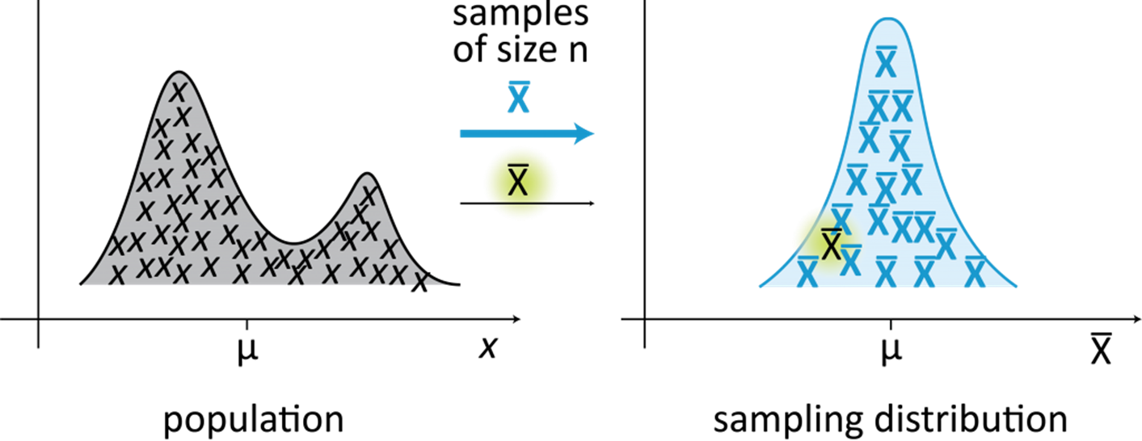
PsychoStat
Normality & Central Limit Theorem
Figure Credit: https://creativemaths.net/blog/sampling-distribution/

Slide 2
Question
Is our sample data and sample statistic consistent with what we would expect to see from samples that really were drawn from a population with certain characteristics?
Example
We think that at the population level, the average hours of sleep for American newborn boys is 7hrs -> ($μ=7$)
We gather a random sample of 200 newborn boys and record their sleep -> the sample average is 6.3hrs -> ($\overline{X}=6.3$)
Is a sample average of 6.3hrs a value we might reasonably expect from a population with a mean of 7hrs?
Approach
Compare observed sample average of 6.3 to the sampling distribution for the mean (distribution of sample means) for a population with a mean of 7
But we can’t actually draw a bajillion samples from the population!
Sampling distributions will be different based on what the population characteristics are
Central Limit Theorem helps us figure out what the sampling distribution for the mean is for any population, provided a few conditions are met

Slide 3
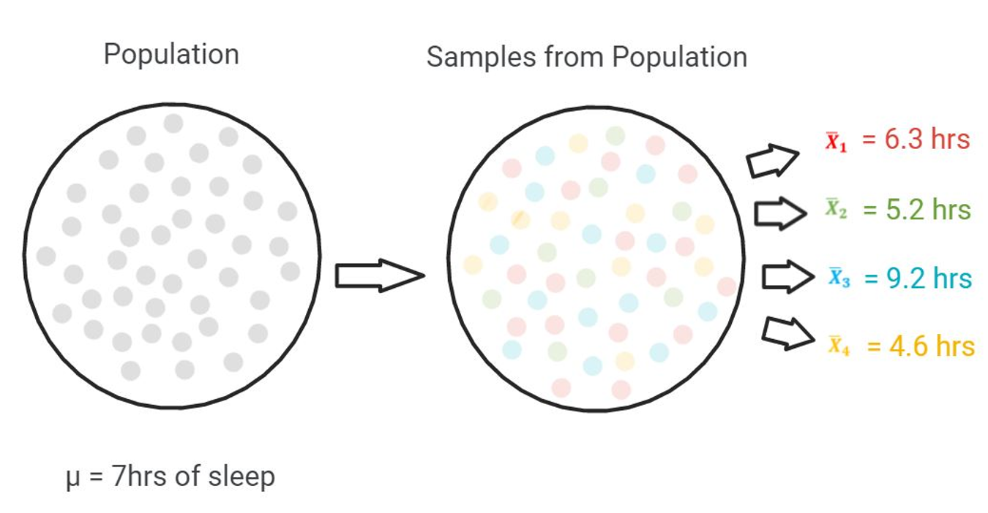
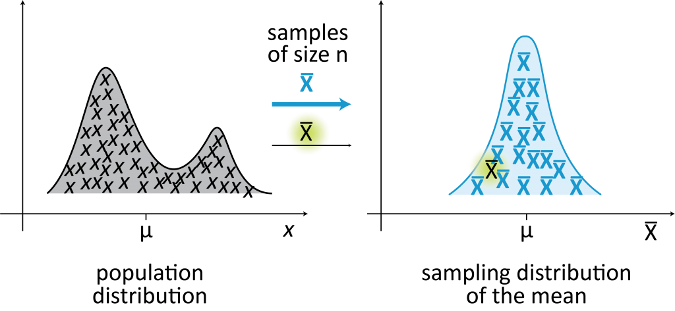
Recap

Slide 4
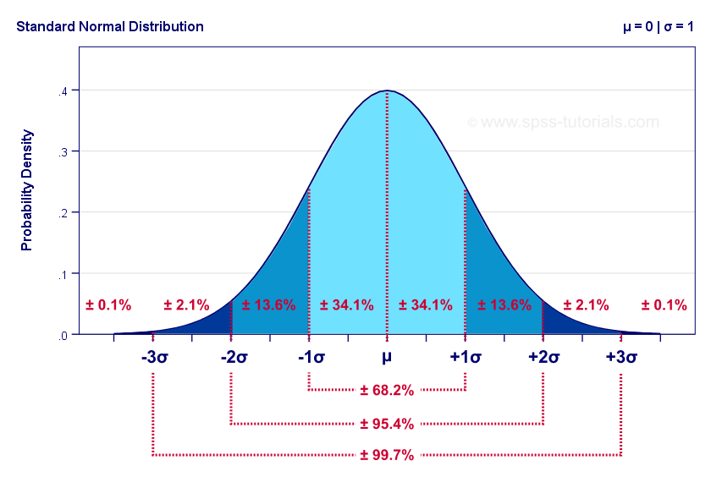
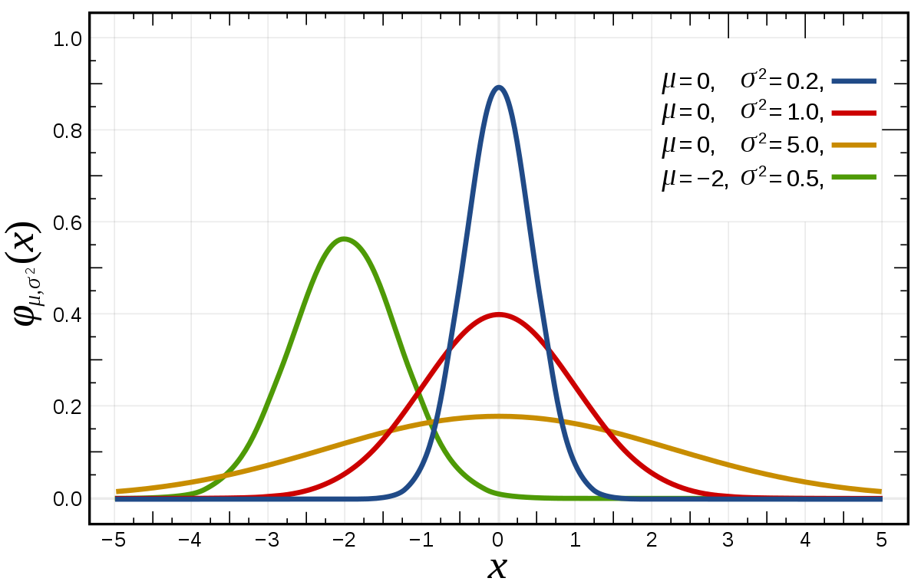
Normal Distribution
If observations follow a normal distribution, then we can make probabilistic statements using just the mean $μ$and standard deviation $σ$

Slide 5
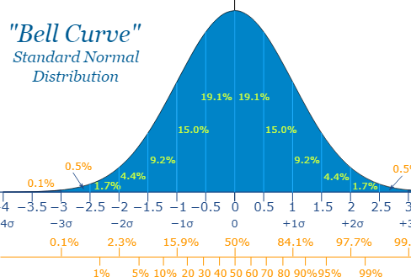
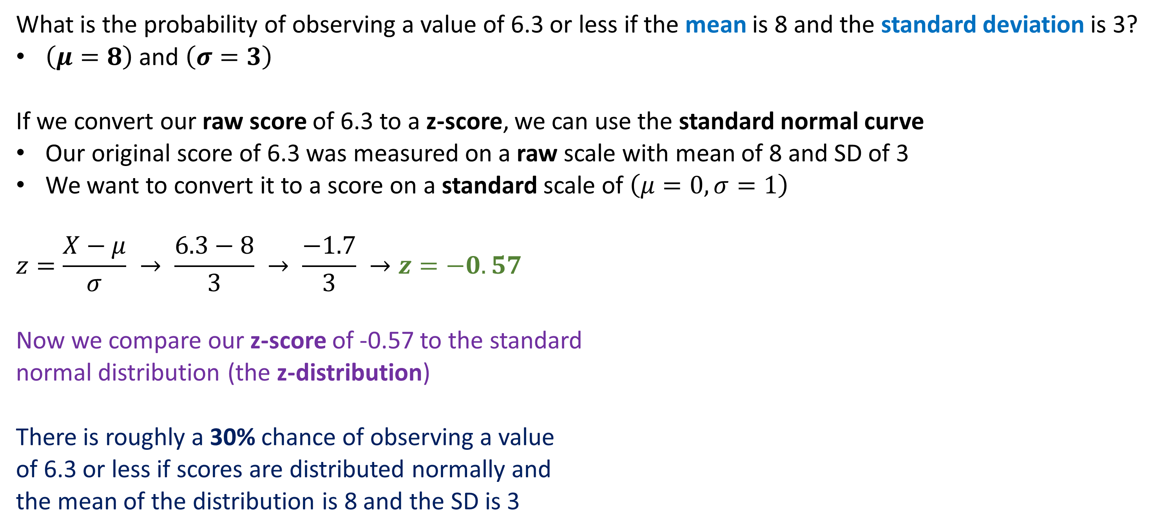
Example
What is the probability of observing a value of 6.3 or less if the mean is 8 and the standard deviation is 3?
$\left(μ=8\right)$ and $\left(σ=3\right)$
If we convert our raw score of 6.3 to a z-score, we can use the standard normal curve
Our original score of 6.3 was measured on a raw scale with mean of 8 and SD of 3
We want to convert it to a score on a standard scale of $\left(μ=0, σ=1\right)$
$$z=\frac{X−μ}{σ} → \frac{6.3−8}{3} → \frac{−1.7}{3} →z=−0.57$$
Now we compare our z-score of -0.57 to the standard
normal distribution (the z-distribution)
There is roughly a 30% chance of observing a value
of 6.3 or less if scores are distributed normally and
the mean of the distribution is 8 and the SD is 3

Slide 6
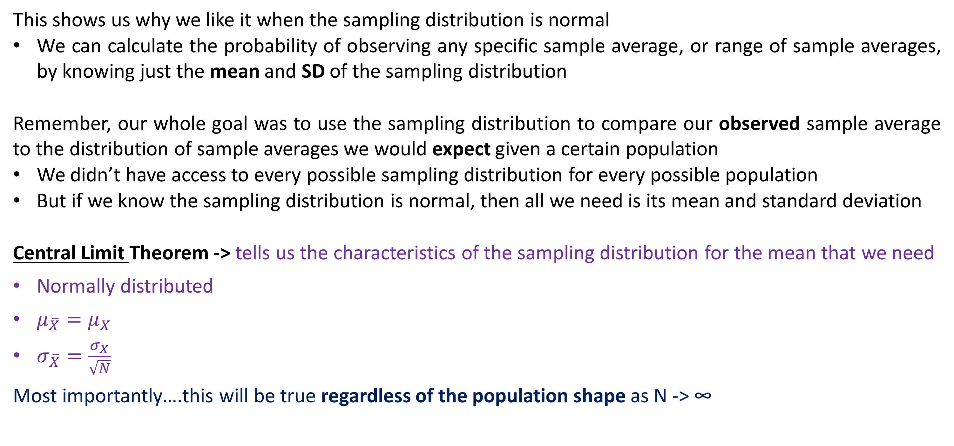
Connecting Back
This shows us why we like it when the sampling distribution is normal
We can calculate the probability of observing any specific sample average, or range of sample averages, by knowing just the mean and SD of the sampling distribution
Remember, our whole goal was to use the sampling distribution to compare our observed sample average to the distribution of sample averages we would expect given a certain population
We didn’t have access to every possible sampling distribution for every possible population
But if we know the sampling distribution is normal, then all we need is its mean and standard deviation
Central Limit Theorem -> tells us the characteristics of the sampling distribution for the mean that we need
Normally distributed
$μ_{\overline{X}}=μ_{X}$
$σ_{\overline{X}}=\frac{σ_{X}}{\sqrt{N}}$
Most importantly….this will be true regardless of the population shape as N -> ∞

Slide 7
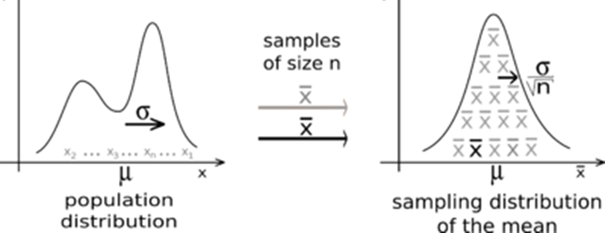
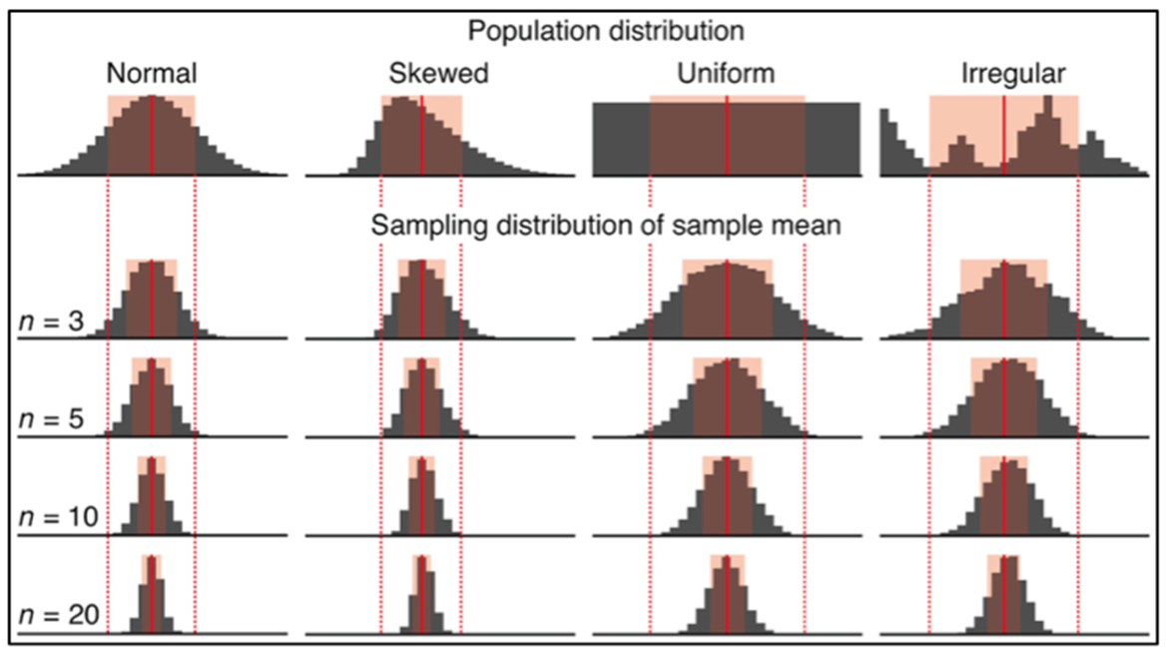
Central Limit Theorem
If the population is normally distributed, then the sampling distribution for the mean will be normal automatically
If the population is NOT normally distributed, then the sampling distribution for the mean will still be normal and have a specific mean & SD if sample size is large enough
The larger N is, the more normal the distribution of sample means will be
Exactly how large N has to be depends on the population shape
EXPLORE
Figure Credit: https://mat117.wisconsin.edu/2-sampling-distribution-of-the-sample-mean/

Slide 8
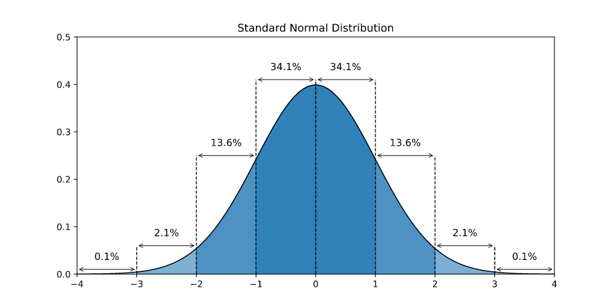

Putting it all together
We have a sample of 200 newborn boys (N = 200) who sleep an average of 6.3 hours per night ($\overline{X}=6.3)$
Our hypothesis is that newborn boys on average sleep 8 hours per night ($μ=8$)
We know that the standard deviation of newborn boys in the population is 3 hours ($σ=3$)
What would be the probability of getting a sample average of 6.3 or less if the population average was 8 and the standard deviation was 3?
$p\left(\overline{X}≤6.3\right) given X \sim Normal(μ=8, σ=3)$
CLT tells us….
$\overline{X} \sim Normal\left(μ_{\overline{X}}=8, σ_{\overline{X}}=\frac{3}{\sqrt{200}}\right)$
Convert to z-score…
$$Z=\frac{\overline{X}−μ}{\frac{σ}{\sqrt{N}}} → \frac{6.3 −8}{\frac{3}{\sqrt{200}}} → \frac{−1.7}{0.21}=−8.02=Z$$
$$→ p\left(Z<−8.02\right)=0.0000001$$

Slide 9
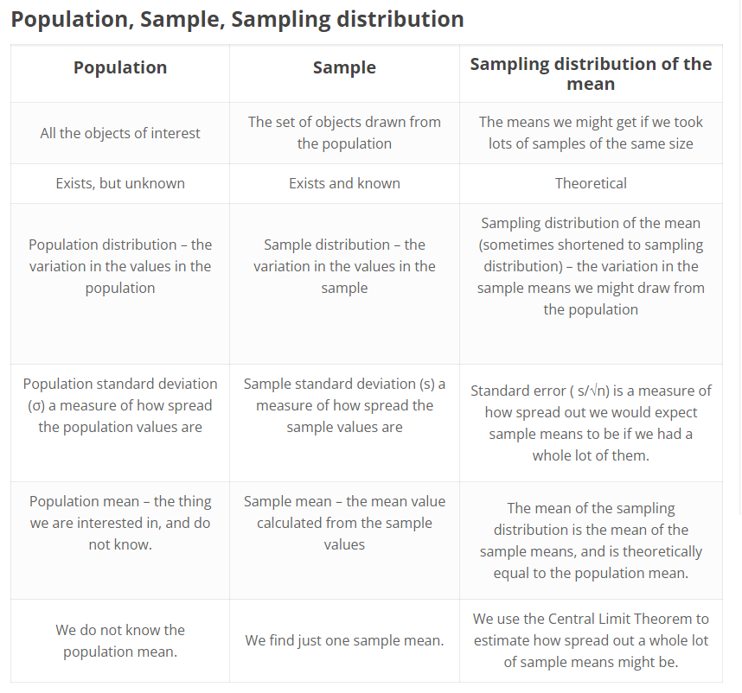
Recap
If we know the population mean and population standard deviation, and our sample size is large enough, the Central Limit Theorem gives us the shape, mean, and SD of the distribution of sample means
We can then use that normal distribution of sample means to compare our observed sample mean against in order to determine the likelihood that our sample average was drawn from a population like the one we hypothesized
Click to open in Lifeliqe
Figure Credit: https://creativemaths.net/blog/sampling-distribution/

